Slide 1
Edge
Security

Slide 2
Security - High-Level Overview
Transport-level security (1 and 2-way TLS)
Client -> Edge
Edge -> Target
IP Access Control
API-level security
OAuth
SAML, JWT, HMAC
CORS
threat protection policies
PCI/HIPAA compliance
Edge user access
RBAC
completely separate Orgs
Data masking in Trace
Vault, encrypted KVM
Response data masking

Slide 3




Apigee Edge - Built with Security
API management
Identity Mgmt & governance
RBAC management IDM integration Global policies User provisioning AD / LDAP Groups
Data privacy
Org boundaries
Encryption
SOC 2, PCI-DSS, HIPAA
Portal
Analytics
Management server
Apps
Back-end
Data privacy
Two-way TLS
API key
OAuth2
Threat Protection
Quota/Spike arrest
SQL threat protection
JSON bomb protection
IP based restrictions
Bot detection
Access control
OAuth2
API key verification
IP access control
Logging & auditing
Data privacy
Two-way TLS
IP access control
Credentials
Logging & auditing

Slide 4

TLS (OPDK)
TLS can be enable on the API runtime critical path as well as on the interfaces exposed for administration and developer's interactions. TLS can be terminated at any of this point independently of the others.
API SERVICES
Router
Message Processor
HTTPS
HTTPS
HTTPS
Client
Backend
openldap
zookeeper
cassandra
qpidd
ANALYTICS
SERVICES
Enterprise UI
Management Server
Qpid / Ingest Server
HTTPS
HTTPS
postgreSQL
DEVELOPER
SERVICES
Developer Portal
postgreSQL
Postgres Server
HTTPS
Legend:
Edge stack
Open Source
‹#›

Slide 5


Transport Layer Level Security
Transport layer level security (1 and 2-way TLS)
Client → Edge
Edge → Target
Client
Edge
Target

Slide 6


Transport Layer Security (1-way TLS)
TRUSTSTORE
03
Verifies certificate
SERVER CERTIFICATE
01
Requests protected resource
SERVER KEYSTORE
02
Presents certificate
CLIENT
SERVER
04
Accesses protected resource

Slide 7
Transport Layer Security (2-way TLS)
TRUSTSTORE
03
Verifies certificate
CLIENT CERTIFICATE
05
Verifies certificate
SERVER CERTIFICATE
CLIENT KEYSTORE
01
Requests protected resource
SERVER KEYSTORE
02
Presents certificate
CLIENT
SERVER
04
Presents certificate
06
Accesses protected resource

Slide 8
Configuring 2-way TLS from Client to Edge (Public Cloud)
01
02
03
Server keystore
Truststore
Virtualhost
Create a keystore and upload certificate and private key of the server
If the client uses a self-signed certificate, or a certificate that is not signed by a trusted CA, create a truststore on Edge that contains the CA chain of the client certificate.
Create a support ticket so the virtualhost is created with the suitable configuration.
<VirtualHost name="myTLSVHost">
<HostAliases>
<HostAlias>apiTLS.myCompany.com</HostAlias>
</HostAliases>
<Port>443</Port>
<SSLInfo>
<Enabled>true</Enabled>
<ClientAuthEnabled>true</ClientAuthEnabled>
<KeyStore>myTestKeystore</KeyStore>
<KeyAlias>myKeyAlias</KeyAlias>
<TrustStore>myTrustStore</TrustStore>
</SSLInfo>
</VirtualHost>

Slide 9
Configuring 2-way TLS from Edge to Target
01
02
03
Client keystore
Truststore
Target server
Create a keystore and upload certificate and private key (These are typically supplied by the target system) using management API.
If the backend server uses a self-signed certificate, or a certificate that is not signed by a trusted CA, create a truststore on Edge that contains the CA chain that you received from the backend server using management API.
Create the target server in the Edge UI with the suitable configuration using management API.
<TargetServer name="target1">
<SSLInfo>
<Enabled>true</Enabled>
<ClientAuthEnabled>true</ClientAuthEnabled>
<KeyAlias>myKeystore</KeyAlias>
<KeyStore>myKey</KeyStore>
<TrustStore>myTrustStore</TrustStore>
</SSLInfo>
</TargetServer>

Slide 10

IP Access Control
IP Whitelisting / Blacklisting using AccessControl policy
<AccessControl name="ACL"> <IPRules noRuleMatchAction="ALLOW"> <MatchRule action="DENY"> <SourceAddress mask="32">10.10.10.10</SourceAddress> </MatchRule> </IPRules> </AccessControl>

Slide 11
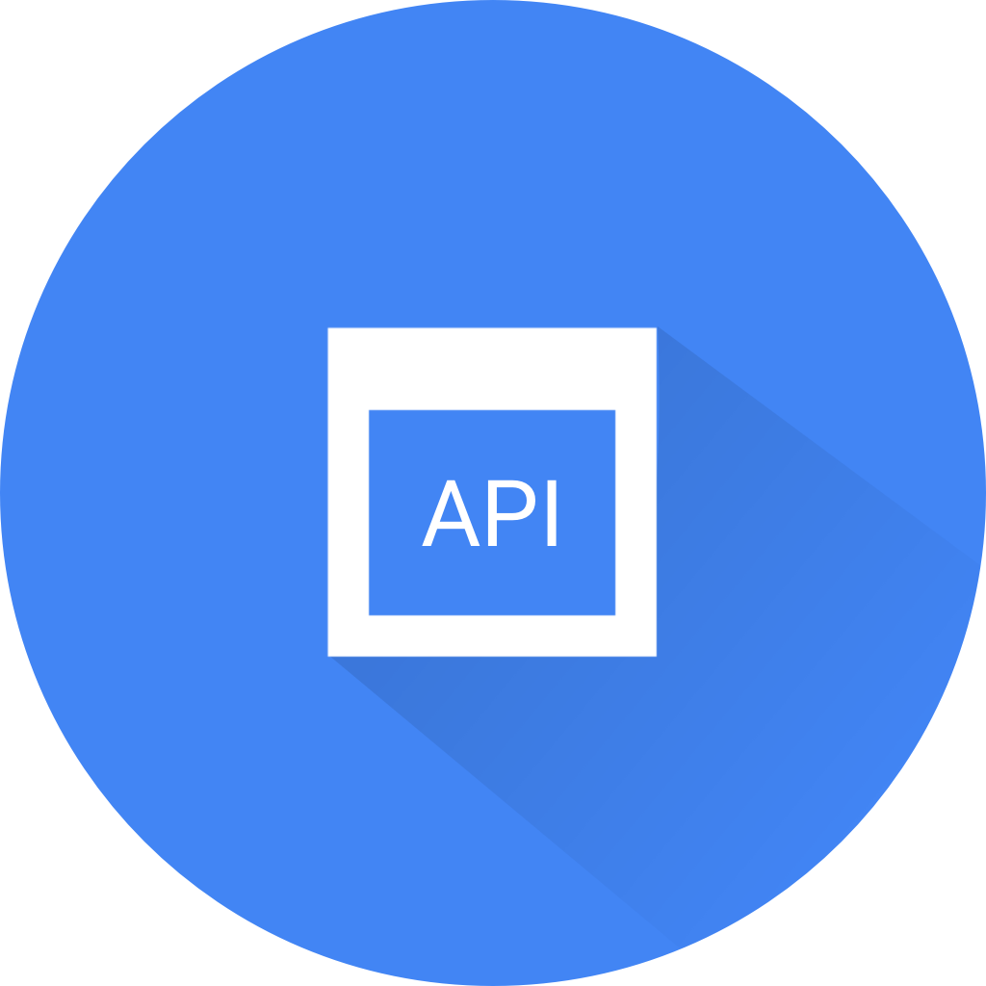
API Level Security
OAuth, OIDC
SAML, JWT, HMAC
CORS
Threat protection policies

Slide 12

API Level Security - OAuth v2
Support for all grant types (authentication code, client credentials, implicit, password)
Support for scopes
Customization tokens and authorization codes through attributes
Explicit revocation of tokens
Revocation and approval of consumer keys
Revocation of tokens by user ID and application ID
Ability to use third-party tokens

Slide 13
API Level Security - SAML, JWT, HMAC
SAML
https://github.com/shahbagdadi/apigee-saml-idp
https://github.com/srinandan/apigee-saml-callout
JWT
https://docs.apigee.com/api-platform/reference/policies/jwt-policies-overview
HMAC
https://github.com/apigee/iloveapis2015-hmac-httpsignature

Slide 14
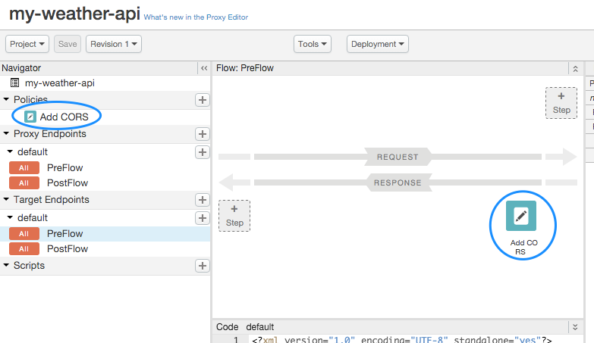
API Level Security - CORS
<AssignMessage async="false" continueOnError="false" enabled="true" name="add-cors"> <DisplayName>Add CORS</DisplayName> <FaultRules/> <Properties/> <Add> <Headers> <Header name="Access-Control-Allow-Origin">*</Header> <Header name="Access-Control-Allow-Headers">origin, x-requested-with, accept</Header> <Header name="Access-Control-Max-Age">3628800</Header> <Header name="Access-Control-Allow-Methods">GET, PUT, POST, DELETE</Header> </Headers> </Add> <IgnoreUnresolvedVariables>true</IgnoreUnresolvedVariables> <AssignTo createNew="false" transport="http" type="response"/> </AssignMessage>

Slide 15



API Level Security - Threat Protection Policies
XMLThreatProtection and JSONThreatProtection policies help us keep malformed messages out of our systems.
XML/JSON
INJECTION
INJECTION
& SCRIPTING
ATTACKS
RegularExpressionProtection policy allows as to scan payloads for SQL, Javascript, etc.
BURSTS OF
TRAFFIC
SpikeArrest policy protects our systems against instantaneous bursts of traffic.

Slide 16
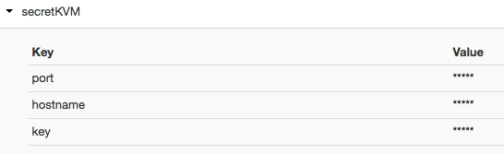
Encrypted KVM
Values are encrypted with an Edge-generated AES-128 cipher key.
Values are masked with asterisks in the UI
In order to avoid the value being displayed in clear text in Trace and debug sessions the "private." prefix needs to be added to the variable name when reading it.

Slide 17
PCI DSS / HIPAA Compliance
PCI DSS (Payment Card Industry Data Security Standard)
Set of security standards designed to ensure that ALL companies that accept, process, store or transmit credit card information maintain a secure environment.
CHECKLIST
x
PCI DSS compliant
Compliant?
x
HIPAA compliant
HIPAA (Health Insurance Portability and Accountability Act)
Sets the standard for protecting sensitive patient data. Any company that deals with protected health information (PHI) must ensure that all the required physical, network, and process security measures are in place and followed.

Slide 18

Edge user access
Best practices:
Have separate organizations for production and non-production.
Restrict what users can do with the out-of-the-box RBAC (Role Based Access Control) provided by Edge

Slide 19
Data Masking and Hiding
Hiding Sensitive Data
You can prevent sensitive data from appearing in the Trace tool and debug sessions by creating custom variables prefixed with "private.".
The difference between hiding and masking is that hidden variables don't appear at all, and masked values are replaced with asterisks in Trace and debug sessions.
Masking Sensitive Data
Edge lets you define 'mask configurations' to mask specific data in trace and debug sessions. Masking configurations can be set at the organization or API proxy level. Role-based capabilities govern which users have access to the data that is defined as sensitive.
When data is masked, it is replaced with asterisks in the trace output.
Mask configurations enable you to identify sensitive data in these sources: XML payloads, JSON payloads, variables.

Slide 20
Response Data Masking
Remove sensitive data from the target response before sending the response to the client. A Javascript policy could be used for that purpose.
Target Response
{
“id”: 1234,
“username”: “john”,
“password”: “xxx”
}
Javascript
var content = context.getVariable(‘response.content’);
var jsonObject = JSON.parse(responseBody);
delete jsonObject.password;
var newContent = JSON.stringify(jsonObject);
context.setVariable(‘response.content, newContent);
Edge Response
{
“id”: 1234,
“username”: “john”
}

